Slide 1
Embedded Computer System
ET0104
DCPE

Slide 2
Chapter 1
Introduction to Embedded Systems

Slide 3
Embedded systems
Special versions of “everyday” computers
  PC: Intel Pentium, Core ix, Atom,
  Apple: Apple T1, T2, M1, Intel x86
Part of larger system
  Smartphone: ARM processor & variants
    (Advanced RISC Machines) – Mediatek/Broadcom/Snapdragon/NXP/TI/ etc etc
  Home appliance: Microcontrollers
Notes:
Embedded computer systems are special versions of the computers we use everyday. The word "embedded" means part of another system. Indeed, much of the intelligence of today's devices owes much to the computers which are part of them. These range
from devices like our remote controls, to washing machines, automobiles and aircraft. These may have several embedded systems in them. Embedded systems are typically smaller in size as compared to desktops.

Slide 4
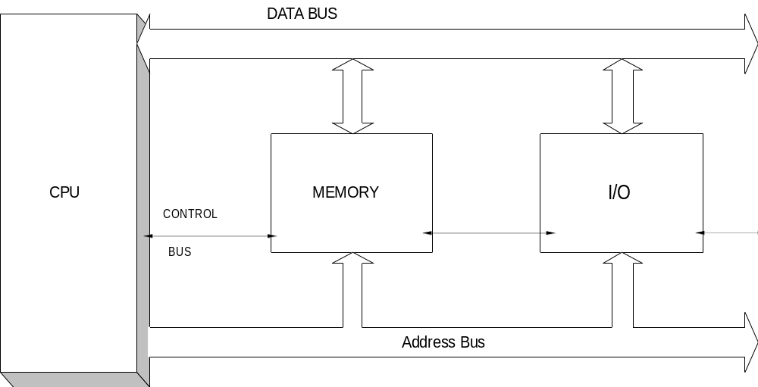
Embedded Computer Organisation
“Embedded” – means PART of a system
Notes:
A basic computer system consists of the Central Processing Unit (CPU), the memory unit and the input and output units. The units are interconnected with buses.

Slide 5
Embedded Computer Organisation
Central Processing Unit (CPU) – processes instructions/data
- responds to external requests
Memory – ROM stores program, fixed data
RAM used for working, changing data
I/O – Inputs from external devices which start processing and Outputs
to display results of processing
Address bus – indicates which memory or I/O device is being accessed
Data bs – transfers data
Control bus – synchronize transfer of data
Notes:
The central processing unit is made up of three parts : the arithmetic/logic unit (ALU), registers and a control unit. The ALU performs arithmetic and logical operations on binary data while the registers are used for storing data, addresses or instructions. The exact number and type of registers depends on the particular computer system. The main register is called an accumulator which usually stores data to be manipulated by the ALU at the beginning of an arithmetic or logic operation. At the end of the operation, the accumulator usually stores the result.
The control unit directs the operation of all other unit, by providing timing and control signals. This unit contains logic and timing circuits that generate the proper signals necessary to execute each instruction in a program. The control unit is also capable of responding to external signals; for example, interrupts. An interrupt request will cause the control circuit to temporarily interrupt the main program execution, jump to a special routine to service the interrupting device, then automatically return to the main program.
The memory unit contains a large number of memory cells, usually RAM and ROM. They are used to store instruction sequences or programs which the computer will execute, the data that is to be processed by the programs, as well as data resulting from the processing. Operation of the memory is controlled by the control unit which signals for either a READ or a WRITE operation.
Input devices are used to supply the data needed for processing or to tell the program how to operate on data. Output devices allow results of the computer operations to be supplied to the user. The input/output devices are also known as peripherals. Common input devices are keyboards and mouse. Examples of output devices are printers and visual display units. Input and output ports are simply the interface circuits which provide the appropriate electrical connections between the input/output devices and the rest of the computer system. Physically an input or output port is just a parallel set of buffers or D flip-flops which latch data when strobed by the CPU.
page 1-2
Control Unit
The control unit directs the operation of all other unit, by providing timing and control signals.
This unit contains logic and timing circuits that generate the proper signals necessary to execute
each instruction in a program. The control unit is also capable of responding to external signals;
for example, interrupts. An interrupt request will cause the control circuit to temporarily
interrupt the main program execution, jump to a special routine to service the interrupting
device, then automatically return to the main program.
Memory Unit
The memory unit contains a large number of memory cells, usually RAM and ROM. They are
used to store instruction sequences or programs which the computer will execute, the data that is
to be processed by the programs, as well as data resulting from the processing. Operation of the
memory is controlled by the control unit which signals for either a READ or a WRITE
operation.
Input/Output Units
Input devices are used to supply the data needed for processing or to tell the program how to
operate on data. Output devices allow results of the computer operations to be supplied to the
user. The input/output devices are also known as peripherals. Common input devices are
keyboards and mouse. Examples of output devices are printers and visual display units.
Input and output ports are simply the interface circuits which provide the appropriate electrical connections between the input/output devices and the rest of the computer system. Physically an input or output port is just a parallel set of buffers or D flip-flops which latch data when strobed by the CPU.
The CPU is linked to other parts of the system by buses. A bus is a group of conductors that has connections to all of the system's main blocks. There are three major buses: the address bus, data bus and the control bus.
Address Bus
The address bus is used by the CPU to send out the address of a memory location that is to be read from or written into; or the address of a particular input or output port. The address bus is unidirectional. Information generally moves in one direction only, originating in the CPU only.
Data Bus
The data bus is bidirectional because data can flow to or from the CPU, memory, or the I/O ports. Any device outputs connected onto the data bus must have three-state buffers, so that they can be floated except when that device is being selected. The number of conductors in the data bus is determined by the number of binary digits the CPU can handle at a given time. However, the quantity of data stored at each location depends on the particular memory device. It may be a single bit, or 4, 8 or 16 bits per location.
The control bus is used to carry signals which synchronise the activities of the separate blocks of the computer system. It tells the memory and the I/O ports whether the CPU is reading or writing data. Two conductors found in the control bus are the READ and the WRITE lines. The READ line activated by the CPU when the CPU wants to retrieve data from the memory or input data from an input device. For example, to read a memory location the CPU places the address on the address bus and a READ signal is placed on the control bus. The memory then outputs the data from the addressed location to the data bus which is then transferred to the CPU data register. When the CPU is to store in memory or output data to an output device, it places the data on the data bus and then activates the WRITE line.
There are also some other control lines present in CPU to perform more complex opera

Slide 6
What we use in this module
ARM Cortex A72
  Vast hardware/software resources
  Many books and courses based on it.
  Shorter development cycle
  Continues to increase in processing power
Notes:
The use of ARM microprocessors over the decades have brought about many thousands of hardware and
software applications. Not to mention the books and courses that build on ARM architecture. This translates into quick application development for sophisticated applications. Also, the processing power of the ARM processors continue to increase.

Slide 7
The need for more computing power
Image, video/audio processing
Floating point data
Sophisticated control algorithms: fuzzy logic, neural networks.
Real-time processing: need faster speed
Notes:
As more uses are found for computing power, greater demand is found for its use. One area is the use of image and video data. An image can easily occupy one megabyte of memory. This requires a large addressing space. Also, manipulating these data require the use of fractional or floating point numbers, rounding off is not an option here.
Furthermore, fixed and floating point numbers need a large number of bits to represent
data. The IEEE format specifies 80 bits. Many processors have incorporate hardware
mathematical coprocessors to take advantage of this.
Sophisticated control algorithms like fuzzy logic, neural networks and statistical signal
processing use a large amount of floating point numbers. Often they use matrix operations as well.
So, while embedded systems may control simple devices, the mathematical background
required to do this optimally and accurately requires a lot of computing power, not just for
games on desktops!

Slide 8
Performance increase
Processing speed: clock frequency
Address bus size: 8 bits, 32 bits, 64 bits
Data bus size: 8 bits,16bits, 32 bits, 64 bits
Architecture: pipelined, parallel, hardware optimization
Notes:
Performance increase can come about in several ways:
Processing speed
Changing the processor speed brings about immediate benefits in terms of faster processing. Faster computers often translate into increased productivity and efficiency.
Address
Manipulating data like sound, images and video need large storage and high speed. These data need to be placed in memory for efficient processing. A 16 bit address only allows 2^16 or 65536 of data locations to be accessed. Today’s processors use 32 bit addresses, with 64 bits are becoming available. It is a major challenge to modify programs to take care of this change.
Data
Most of the time, a unit of data manipulated is 8 bits or a byte. More sophisticated mathematical manipulations require many more bits to prevent loss of precision. Depending on whether one is using fixed or floating point, using 80 bits for mathematical data is common.
Also, instead of fetching 8 bits at a time, it is more efficient to fetch and manipulate them in units of 32 bits at a time, hence the reference to 32 bit data. Thus newer processors perform additions, etc on 32 bit data!
This can also cause problems in high level programming languages as the definition of an integer (the basic unit of data manipulation) will change when moving to a new processor.
Architecture
This refers to changing how data flows within the processor, making it more efficient. For example, having two or more processing units allow simultaneous fetching of data and actual processing of data. Also we may pre-fetch data or code that is not required yet, anticipating when it is used and place it in memory that is faster so it executes faster.
The hardware may also be optimized so that certain commonly instructions can be
executed much faster than others. Architectural changes may introduce subtle errors in programs if they are time dependent. Otherwise, it should not change the running of the program significantly.

Slide 9
Embedded system characteristics
DESKTOP SYSTEMS
Keyboard,
Programs
Display,
Mouse,
User,
Printer,
HardDisk
System
HardDisk,
=====
======
ROM,
RAM
LED,
LCD,
Switches,
Motor,
sensors,
4
bit,
32
bit
processor
Relay,
keypad
Buzzer
INPUT PROCESS OUTPUT
EMBEDDED SYSTEMS
Notes:
As can be seen, the inputs to a desktop system differ from those of an embedded system. The processors however, may be similar. The amount of memory will differ, desktops being able to physically access more amounts of memory. Again, the outputs are different.

Slide 10
Embedded system characteristics
Fixed purpose
  Normally control device/process.
  Desktop computers - variety of uses
    e.g.games, word processing …
Notes:
These systems are used for a fixed purpose. This is normally to control another device or
process. Desktop computers can be used for a variety of purposes - games, word processing and so on.

Slide 11
Embedded system characteristics
Smaller size
  embedded system should be relatively smaller
  constraints on physical size
Notes:
The system must be relatively smaller than the system it is part of. This places constraints on the physical size of the embedded system.

Slide 12
Embedded system characteristics
Limited resources: RAM, ROM, I/Os
  memory is limited esp. RAM
  mostly never use hard disks
  programs stored in ROM
Notes:
This is related to the point about physical size. The amount of memory is limited and most of the time, this is in terms of RAM. Embedded systems mostly never use hard disks and programs are stored in ROM.

Slide 13
Embedded system characteristics
Failure tolerance
  unpredictable physical environment
  fail "gracefully“
  NOT “hang” system – control is lost!
Notes:
Because of the unpredictable nature of the physical environment, the systems should be capable of failing "gracefully" if it meets unpredictable circumstances. This is much preferable to the system "hanging".

Slide 14
Embedded system characteristics
Real time control
  The speed of the embedded system is fast enough to affect the operation of the environment.
  dependent on system
    remote control device operates in terms of seconds.
    But an aircraft control system works in terms of thousandths of a second.
  complexity of the calculations required
  human interactions -fractions of second
    not make sense for a computer to work in millionths of a second
Notes:
The speed of the embedded system is fast enough to affect the operation of the environment. For example, a remote control device operates in terms of seconds. But an aircraft control system works in terms of thousandths of a second. Of course the complexity of the calculations required for such a system plays a major part in determining what kind of system to use.
In many cases, especially involving human interactions which take place in fractions of a
second, it does not make sense for a computer to work in millionths of a second here.

Slide 15
Embedded system characteristics
Guaranteed response time
  respond to a device
  request in a minimum time
  especially true when multitasking
  may be strict conditions!
Notes:
Closely related to real time control, is the need for the embedded system to respond to a device or user request in a minimum time. This is especially true when systems are running several tasks at the same time. Important processes have stringent conditions on this.

Slide 16
Embedded system characteristics
Reliability
  work in hostile environments
  extremes of heat/cold mechanical vibration/shock
  electromagnetic interference, radiation, chemical pollutants.
  part of a larger system
    installed in physically inaccessible places
  difficult to perform software updates
  have to run 24/7 for years
Notes:
An unusually high emphasis is placed on this, especially when human lives are concerned. To complicate this is the fact that embedded systems often work in environmentally hostile
environments. Aircraft are subjected to extremes of heat and cold and mechanical vibration and shock. Other factors are electromagnetic interference, radiation and chemical pollutants.
Whatever environment the host system is operating in, will subject the embedded system to the same. Being part of a larger system, the embedded system may be installed in physically inaccessible places. It may be very difficult to perform software updates and have to run continuously for years on end.

Slide 17
Embedded system characteristics
Simple I/O: keypad, LED/LCD, relay, switch
  don’t need elaborate input/output devices
    Keyboard/mouse/display/sound
  input from switches, sensors, or small size keypads.
  output to motors, relays, buzzers, LEDS, LCDs
Notes:
Since embedded systems help control a larger system, it does not need elaborate input devices like a keyboard or a mouse or a display screen or a sound system for output. Most, it will read from switches, sensors, or small size keypads. It may output to motors, relays, buzzers, light emitted diodes, liquid crystal displays. Sometimes, a touch sensitive screen is used for input and output.

Slide 18
Embedded system characteristics
Low power consumption
  part of a larger system
  should not consume too much power!
Notes:
Being part of a larger system, an embedded system should not consume too much power relative to the host system.

Slide 19
Embedded system characteristics
Low cost
  does not add appreciably to total system cost
Notes:
This is needed, so it does not add appreciably to the total cost of the host system.

Slide 20
Hardware considerations
Interrupts
Hardware timers
Direct Memory Access
Power management
Notes:
Embedded systems frequently have to work with devices external to itself. For example, it has to receive input, from a keyboard, move an object and display the results of its processing to a display device like an LED display.
Mechanical control has to be in a precise manner. As mentioned above, the system often has to service several devices at the same time. Some of these devices have a large amount of data to be transferred in short time. Various hardware techniques have been built into the processor to help perform these tasks. These are: i) interrupts ii) hardware timers iii) direct memory access.

Slide 21
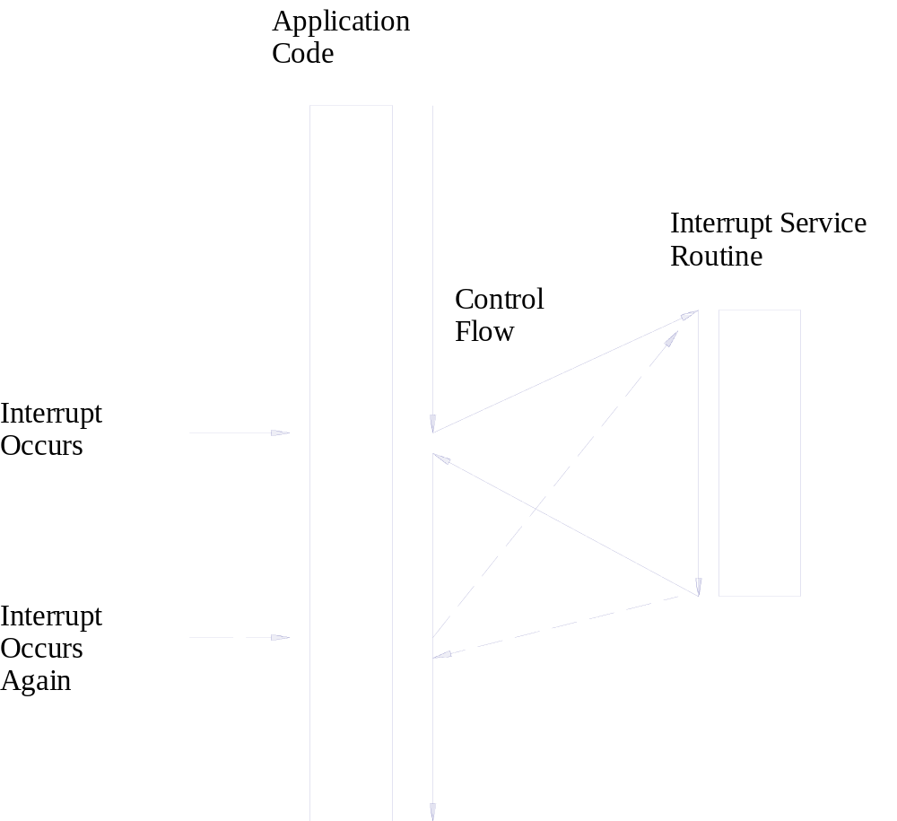
Interrupts
ISR
Notes:
Embedded systems work at a high speed, in terms of millions of instructions per second, but often it interfaces to devices which operates much slower than it. Data input from humans for example, occur at millisecond rates, and the eye cannot detect events occurring at speeds faster than this. For the processor to wait for input and output is time consuming and inefficient. One way to improve this situation is through the use of interrupts.
For efficient handling of several devices, such as in a real-time system, the software to handle the inputs and outputs is often handled by using interrupts. A characteristic of real-time control software is that it must read input changes when they occur and change outputs in a timely fashion, usually within a time limit. For example, a processor controlling the motion of a robot arm must stop it as it detects that the arm has reached the target
position.
Most of the time, the processor will execute its main program. At any time, an external event may cause an interruption which causes the processor to suspend its current activity. The processor handles the interrupt by jumping to a special program called an interrupt service routine (ISR). It then resumes what it was doing. This differs from a subroutine call, because the locations where the routine resides been preassigned.
Alternatively, if there is a critical section of a program which cannot have any interruptions. The main processor can set certain register flags to keep interrupts from occurring while it executes this code.
When an interrupt occurs, we have to determine which device activated it. The appropriate ISR is then chosen.

Slide 22
Ubiquity & Connectivity of embedded systems
Increasing computing power & smartphones
  Drives the connectivity of devices
Internet Of Things
  Data captured by all kinds of consumer devices
  For analytics, future trends
Large portion are self powered
  Must conserve energy
ALSO
  Dwindling global energy sources
  Global warming
Notes:
ubiquitous computing is the growing trend of embedding computational capability (generally in the form of microprocessors) into everyday objects to make them effectively communicate and perform useful tasks in a way that minimizes the end user's need to interact with computers as computers. Pervasive computing devices are network-connected and constantly available.
Unlike desktop computing, pervasive computing can occur with any device, at any time, in any place and in any data format across any network and can hand tasks from one computer to another as, for example, a user moves from his car to his office. Pervasive computing devices have evolved to include:
laptops;
notebooks;
smartphones;
tablets;
wearable devices;
and sensors (for example, on fleet management and pipeline components, lighting systems, appliances).

Slide 23
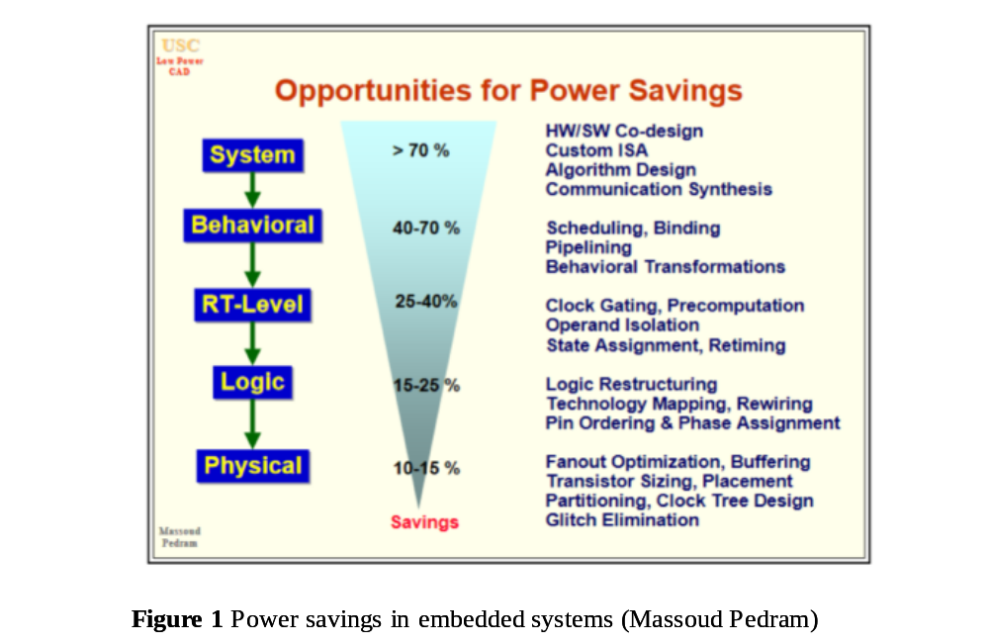
Reducing power use
A large portion of power savings come from informed PROGRAMming using processors’ features
A knowledge of the POWER supply sources is useful.
The PROCESSOR’s power saving hardware features should be utilised.
Notes:
One of the best ways of reducing the amount of power consumed by a microcontroller is by writing efficient and well optimized firmware. This directly affects the amount of work done by the CPU per time and this, by extension contributes to the amount of power consumed by the microcontroller.

Slide 24
Reduce power use
PROGRAM
  Use code that executes quickly– see tips in Chapter 12
  Use low power modes extensively
    Main loop is just entry to low power operation
    Other operations become ISRs
POWER
  Use Low Drop Out voltage regulators - quiet
  Use Switch Mode Power Supplies (SMPS) - noisy
  Consider battery types/alternative power
PROCESSOR
  Use different operating frequencies/voltages
  Understand SLEEP/HIBERNATE modes

Slide 25
Timers
Software time (delay loops)
  Processor occupied
  Not accurate, execution of instruction varies
  Cannot multi-tasking
How hardware timer chip works?
  Set a value to timer
  Timer counts down, when done, causes INT
  Accurate, basics of multi-tasking OS
Notes:
In order to control external devices in a precise manner, it is important to have a source of precise time events. While software delay loops may work and are simple, there are problems:
i) These normally involve loops with a high count. This does not allow the processor to
perform any other tasks.
ii) In modern processors, the execution time of an instruction can vary, depending on
various instruction pre-fetch schemes, like caching.
iii) A proper multitasking operating system cannot work on software loops as this makes
task management very difficult.
Thus timers, external to the CPU, but which may be on or off-chip are essential. Timers may be used in many ways, but the most common is to:
i) Set a value to the timer
ii) Allow it to count up/down, and then cause an interrupt.
iii) The frequency of interrupts can be set so that a user can call up a delay using
convenient units like milliseconds.
It is possible to directly read the values of the timer register for short duration events. As
mentioned before, timer interrupts are the basis of multitasking operating systems.

Slide 26
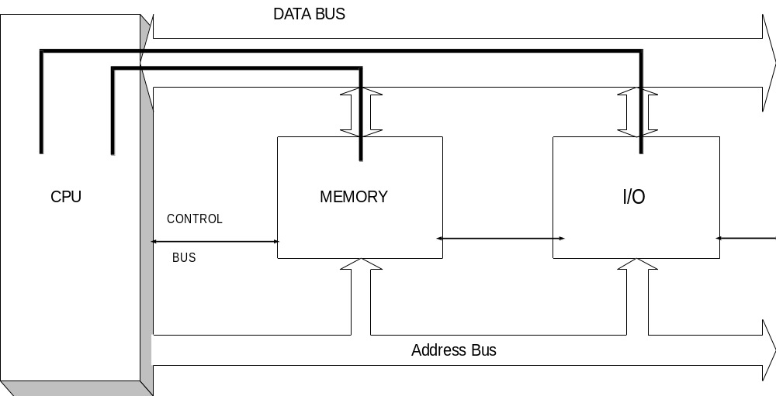
Normal Memory Access

Slide 27
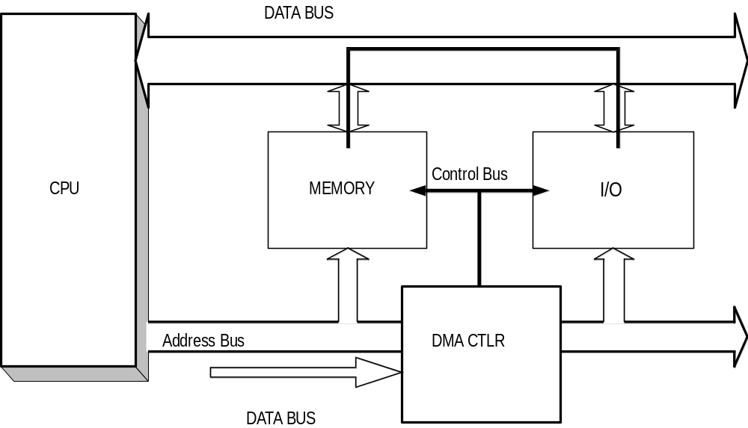
Direct Memory Access

